Slide 1
Features of Bitcoin
Bitcoin transactions

Slide 2
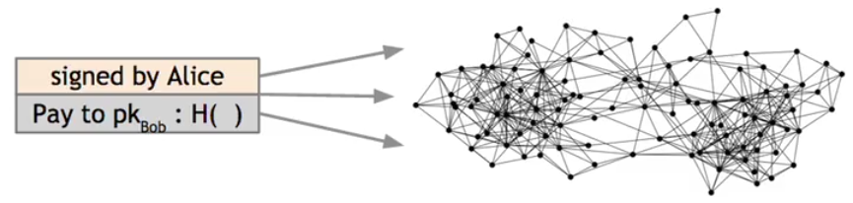
bitcoin_transaction example:
The transaction is going to have:
Alice's signature used by other nodes to check the orgin.
Bob's public key, which also accesses the address at which he wants to receive bitcoins
a hash of the previous transaction. This is a way for Alice to link this transaction to her receipt of this coin from someone else previously

Slide 3
An account-based Model (not Bitcoin)
time
might need to scan backwards until genesis!
Create 25 coins and credit to Alice_{ASSERTED BY MINERS}
Transfer 17 coins from Alice to Bob_{SIGNED(Alice)}
Transfer 8 coins from Bob to Carol_{SIGNED(Bob)}
Transfer 5 coins from Carol to Alice_{SIGNED(Carol)}
is this valid?
Transfer 15 coins from Alice to David_{SIGNED(Alice)}
SIMPLIFICATION: only one transaction per block

Slide 4
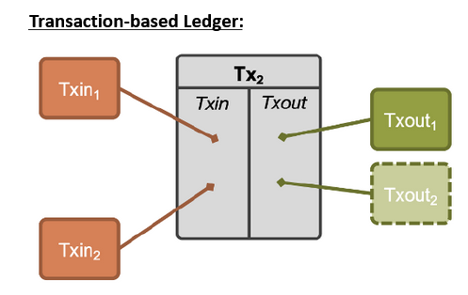
A transaction-based ledger (Bitcoin)

Slide 5
Example
Inputs: Ø
Outputs: 25.0→Alice
1
time
we implement this with hash pointers
change address
Inputs: 1[0]
Outputs: 17.0→Bob, 8.0→Alice
SIGNED(Alice)
2
Inputs: 2[0]
Outputs: 8.0→Carol, 7.0→Bob
SIGNED(Bob)
finite scan to check for validity
3
Inputs: 2[1]
Outputs: 6.0→David, 2.0→Alice
SIGNED(Alice)
4
is this valid?
SIMPLIFICATION: only one transaction per block
Notes:
This is called a “change address”

Slide 6
Merging value
time
Inputs: ...
Outputs: 17.0→Bob, 8.0→Alice
SIGNED(Alice)
1
...
Inputs: 1[1]
Outputs: 6.0→Carol, 2.0→Bob
SIGNED(Carol)
2
...
Inputs: 1[0], 2[1]
Outputs: 19.0→Bob
SIGNED(Bob)
3
SIMPLIFICATION: only one transaction per block

Slide 7
Joint payments
time
Inputs: ...
Outputs: 17.0→Bob, 8.0→Alice
SIGNED(Alice)
1
...
Inputs: 1[1]
Outputs: 6.0→Carol, 2.0→Bob
SIGNED(Carol)
2
...
Inputs: 2[0], 2[1]
Outputs: 8.0→David
SIGNED(Carol), SIGNED(Bob)
3
two signatures!
SIMPLIFICATION: only one transaction per block

Slide 8
The real deal: a Bitcoin transaction
{ "hash":"5a42590fbe0a90ee8e8747244d6c84f0db1a3a24e8f1b95b10c9e050990b8b6b", "ver":1, "vin_sz":2, "vout_sz":1, "lock_time":0, "size":404, "in":[ { "prev_out":{ "hash":"3be4ac9728a0823cf5e2deb2e86fc0bd2aa503a91d307b42ba76117d79280260", "n":0 },
"scriptSig":"30440..." }, { "prev_out":{ "hash":"7508e6ab259b4df0fd5147bab0c949d81473db4518f81afc5c3f52f91ff6b34e", "n":0 }, "scriptSig":"3f3a4ce81...." } ], "out":[ { "value":"10.12287097", "scriptPubKey":"OP_DUP OP_HASH160 69e02e18b5705a05dd6b28ed517716c894b3d42e OP_EQUALVERIFY OP_CHECKSIG" } ]
}
metadata
input(s)
output(s)

Slide 9
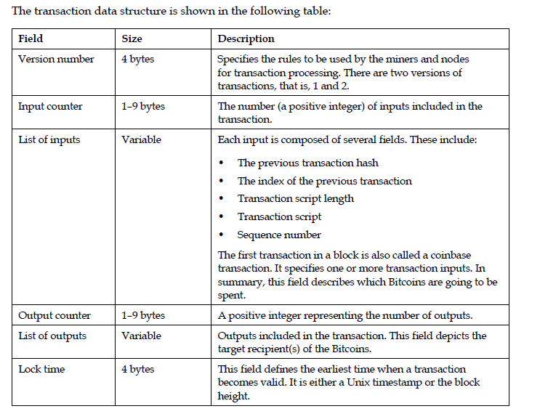
Transaction Data Structure

Slide 10
The real deal: transaction metadata
{ "hash":"5a42590...b8b6b", "ver":1, "vin_sz":2, "vout_sz":1, "lock_time":0, "size":404,
...
}
transaction hash
housekeeping
“not valid before”
more on this later...
housekeeping

Slide 11
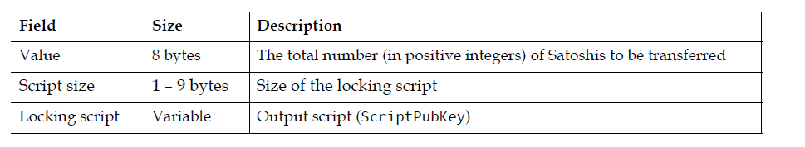
Transaction output data structure:

Slide 12
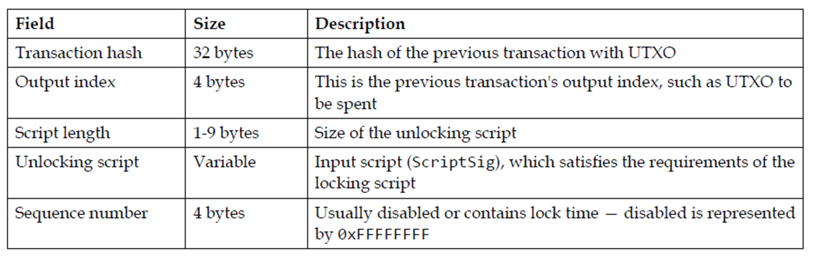
Transaction input data structure:

Slide 13
The real deal: transaction inputs
"in":[ { "prev_out":{ "hash":"3be4...80260", "n":0 },
"scriptSig":"30440....3f3a4ce81" }, ...
],
previous
transaction
signature
(more inputs)

Slide 14
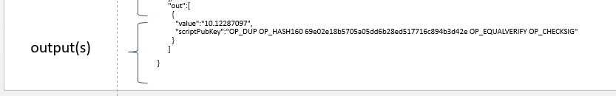

Slide 15


Slide 16
How it works
1. The locking script (scriptPubkey) is stored in the UTXO and defines the conditions for spending the bitcoins.
2. The spender creates an unlocking script that satisfies the conditions of the locking script.
3. The unlocking script (ScriptSig) is combined with the locking script to create a valid transaction.
4. The transaction is verified by the network, and if valid, the bitcoins are spent.

Slide 17
UTXOs are stored in the Bitcoin blockchain and are used to track the ownership of bitcoins. Each UTXO has the following properties:
- Transaction ID: The ID of the transaction that created the UTXO.
- Output index: The index of the output in the transaction.
- Address: The Bitcoin address that received the UTXO.
- Amount: The amount of bitcoins in the UTXO.
- ScriptPubKey: The locking script that defines the conditions for spending the UTXO.

Slide 18
When a user wants to spend their bitcoins, they create a new transaction that references the UTXO(s) they want to spend.
And provides an unlocking script to satisfy the conditions of the locking script.
If the transaction is valid, the UTXO is marked as spent, and a new UTXO is created for the recipient.

Slide 19
Bitcoin scripting language (“Script”)
Design goals
Built for Bitcoin (inspired by Forth)
Stack-based
non Turing complete
Reverse Polish Notation (RPN):
with two types of instructions
Support for cryptography
Example of RPN in Bitcoin Script
A simple Bitcoin Script:
<Signature> <PublicKey> OP_CHECKSIG
Signature and PublicKey are pushed onto the stack.
OP_CHECKSIG pops these values from the stack and verifies the signature.
In RPN, this means:The operands (Signature, PublicKey) come first.
The operator (OP_CHECKSIG) follows.
In Short, Bitcoin's script is designed to be simple, predictable, and always finish in a finite number of steps.

Slide 20
Bitcoin script instructions
256 opcodes total (15 disabled, 75 reserved)
Arithmetic
Logic/data handling
Crypto!
Hashes
Signature verification
Multi-signature verification

Slide 21
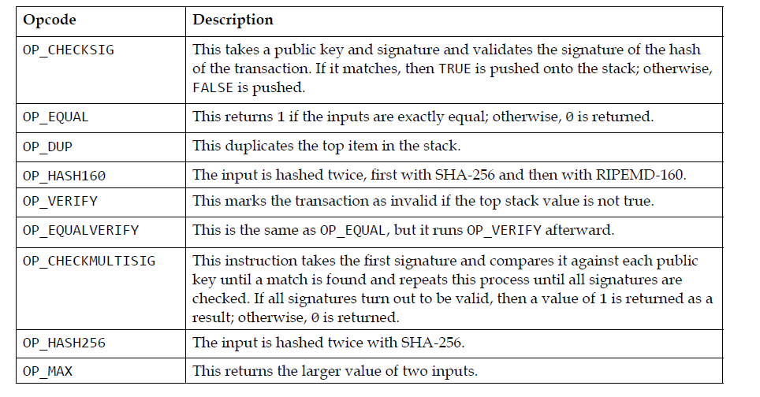
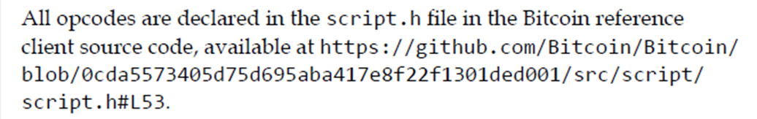
Commonly Used opcodes:

Slide 22
Types of standard Transaction scripts:
1. P2PKH (Pay-to-Public-Key-Hash) Script:
OP_DUP OP_HASH160 <pubKeyHash> OP_EQUALVERIFY OP_CHECKSIG
Example:
OP_DUP OP_HASH160 76a914b4736d6f2b3d6f6f6f6f6f6f6f6f6f6f6f6f OP_EQUALVERIFY OP_CHECKSIG
This script sends Bitcoins to a public key hash, requiring the recipient to provide the corresponding public key and signature to spend the funds
1. Public Key Hash: The sender generates a public key hash (address) from the recipient's public key using a one-way cryptographic function (RIPEMD-160 and SHA-256).
2. Script Creation: The sender creates a P2PKH script, which includes:
- OP_DUP (duplicate top stack element)
- OP_HASH160 (hash top stack element with RIPEMD-160 and SHA-256)
- Public Key Hash (address)
- OP_EQUALVERIFY (check if top two stack elements are equal)
- OP_CHECKSIG (verify signature)
3. Transaction: The sender creates a transaction with the P2PKH script and signs it with their private key.
4. Verification: The network verifies the transaction by:
- Hashing the recipient's public key to match the public key hash (address)
- Checking the signature with the recipient's public key

Slide 23
2.P2SH (Pay-to-Script-Hash) Script:
OP_HASH160 <scriptHash> OP_EQUAL
Example:
OP_HASH160 51b7b5e8f6f6f6f6f6f6f6f6f6f6f6f6f OP_EQUAL
This script sends Bitcoins to a script hash, requiring the recipient to provide the corresponding script and inputs to spend the funds.
1. Script Creation: The sender creates a P2SH script, which includes:
- Redeem script (contains the actual spending conditions)
- OP_HASH160 (hash redeem script with RIPEMD-160 and SHA-256)
- Script Hash (address)
2. Transaction: The sender creates a transaction with the P2SH script and signs it with their private key.
3. Verification: The network verifies the transaction by:
- Hashing the redeem script to match the script hash (address)
- Executing the redeem script to check spending conditions

Slide 24
3. Multisig Script:
OP_2 <pubKey1> <pubKey2> OP_2 OP_CHECKMULTISIG
Example:
OP_2 03f3f3f3f3f3f3f3f3f3f3f3f3f3f3f3f 03f4f4f4f4f4f4f4f4f4f4f4f4f4f4f4 OP_2 OP_CHECKMULTISIG
This script requires multiple signatures (in this case, 2) to spend the funds.

Slide 25
Key differences
- Address type: P2PKH uses a public key hash (address), while P2SH uses a script hash (address).
- Script complexity: P2PKH has a fixed, simple script, while P2SH allows for more complex scripts and smart contracts.
- Verification: P2PKH verifies a signature, while P2SH executes a redeem script to check spending conditions.
Example
Suppose Alice wants to send 1 BTC to Bob's multi-signature wallet, requiring 2-of-3 signatures from Bob, Charlie, and David.
- P2PKH: Alice sends 1 BTC to Bob's public key hash (address). Bob can spend the funds alone.
- P2SH: Alice sends 1 BTC to a script hash (address) containing the multi-signature redeem script. The script requires 2 signatures from Bob, Charlie, and David to spend the funds.

Slide 26
4. Null data/OP-RETURN Script:
OP_RETURN <data>
Example:
OP_RETURN 6a146f6f6f6f6f6f6f6f6f6f6f6f6f6f
This script stores arbitrary data on the blockchain, marking the transaction as invalid.

Slide 27
Bitcoin script execution example
✓
<pubKeyHash?>
<pubKey>
<pubKeyHash>
<pubKey>
<sig>
true
<sig> <pubKey> OP_DUP OP_HASH160 <pubKeyHash?> OP_EQUALVERIFY OP_CHECKSIG

Slide 28
5. SegWit (Segregated Witness)Address Formats
P2WPKH (Pay-to-Witness-Public-Key-Hash):
Format: Starts with bc1.
Example: bc1qw508d6qejxtdg4y5r3zarvaryvhm3vcxz6s8cp.
P2WSH (Pay-to-Witness-Script-Hash):
Used for multisig or complex scripts.
Format: Starts with bc1.

Slide 29
Comparison of P2WPKH and P2PKH
Feature | P2PKH | P2WPKH
Address Format | Base58, starts with 1 | Bech32, starts with bc1
Signature Placement | Part of transaction data | In witness data
Transaction Size | Larger | Smaller
Fees | Higher | Lower
Transaction Malleability | Vulnerable | Fixed

Slide 30
Challenges and Criticisms:
1. Slow Adoption:
Many users and platforms were slow to adopt SegWit due to the need for wallet and software updates.
2. Not a Permanent Fix:
While SegWit improves scalability, it is not a long-term solution to Bitcoin's scalability issues. It works in conjunction with other solutions like the Lightning Network.

Slide 31
Script Properties
The main properties of Bitcoin language and scripts are the following:
Every Bitcoin script can only produce two outcomes. It can either execute successfully or return an error. If it fails during transaction validation, the entire transaction becomes invalid and won't be added to the blockchain.
Bitcoin scripting language is very small, Bitcoin's scripting language is limited to 256 instructions (1 byte each). 15 instructions are disabled, and 75 are reserved for future use, so they currently have no function.
Bitcoin scripting language includes instructions to handle basic arithmetic and logic, managing errors and perform cryptographic tasks like hashing and verifying signatures.
Bitcoin scripts are simple, efficient, and focused on essential functions

Slide 32
Applications of Bitcoin Scripts

Slide 33
Some are
1. Escrow transactions
2 . Green addresses
3. Efficient micro-payments

Slide 34

Example 1:Escrow transactions
(disputed case)
(normal case)
Pay x to Bob
SIGNED(ALICE, BOB)
Pay x to Alice
SIGNED(ALICE, JUDY)
Judy
To: Alice
From: Bob
PROBLEM: Alice wants to buy online from Bob. Alice doesn’t want to pay until after Bob ships.
Bob doesn’t want to ship until after Alice pays.
Alice
Pay x to 2-of-3 of Alice, Bob, Judy (MULTISIG)
SIGNED(ALICE)
Bob
Notes:
Gavel from OpenClipArt.com

Slide 35
Example 2 : Green addresses
A Green Address in Bitcoin refers to a trusted address controlled by a reputable third party, such as a bank or a payment processor, that guarantees the validity of a transaction.
This concept is used to facilitate instant transaction acceptance even before the transaction is confirmed on the blockchain.

Slide 36
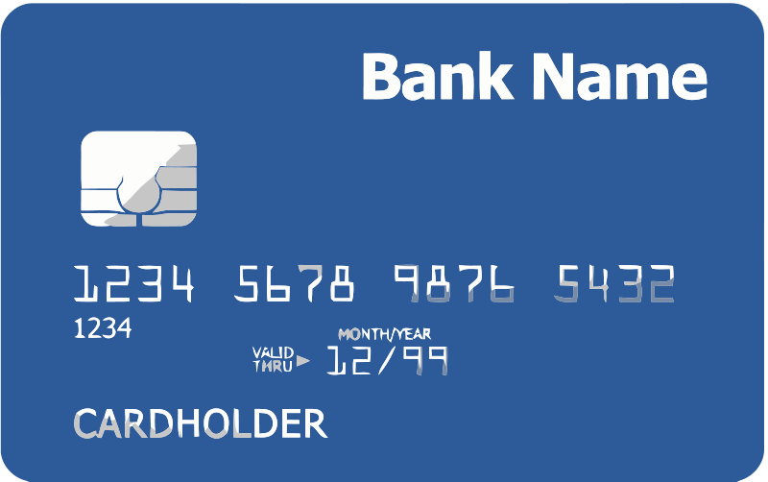
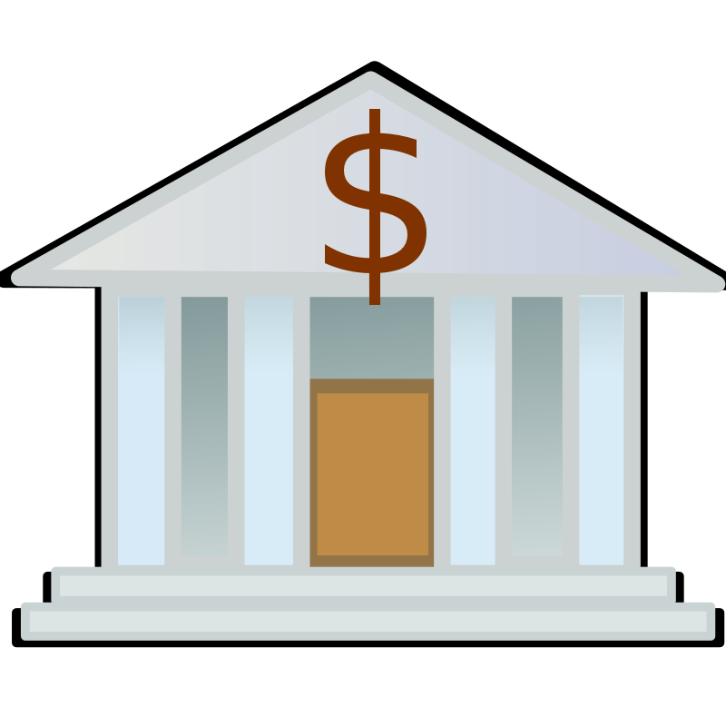
004 days since last double spend!
It’s me, Alice! Could you make out a green payment to Bob?
Bank
Pay x to Bob, y to Bank
SIGNED(BANK)
No double spend
Alice
Bob
Notes:
These are mostly dead thanks to Mt. Gox, Instawallet

Slide 37
Example 3: Efficient micro-payments
What if Bob never signs??
Input: x; Pay 42 to Bob, 58 to Alice
SIGNED(ALICE) SIGNED(BOB)
all of these could be double-spends!
Input: x; Pay 42 to Bob, 58 to Alice
SIGNED(ALICE)___________
With this feature Alice knows that she can get her money back if Bob never signs the transactions.
...
Alice demands a timed refund transaction before starting
Input: x; Pay 04 to Bob, 96 to Alice
SIGNED(ALICE)___________
Input: x; Pay 100 to Alice, LOCK until time t
SIGNED(ALICE) SIGNED(BOB)
I’m done!
I’ll publish!
Input: x; Pay 03 to Bob, 97 to Alice
SIGNED(ALICE)___________
Input: x; Pay 02 to Bob, 98 to Alice
SIGNED(ALICE)___________
Input: x; Pay 01 to Bob, 99 to Alice
SIGNED(ALICE)___________
PROBLEM: Alice wants to pay Bob for each minute of phone service. She doesn’t want to incur a transaction fee every minute.
Bob
Alice
Input: y; Pay 100 to Bob/Alice (MULTISIG)
SIGNED(ALICE)
Notes:
What if Bob never paid?

Slide 38
It is impossible to redeem two different transactions generated by Alice, since they are all technically double spends of the same beginning transaction. If both parties are operating normally, Bob will never sign any transaction but the last one, so the blockchain won't actually see any attempt of double-spending.

Slide 39
problem of the micro-payments protocol could be that Bob will never signs any of the transactions, so all the money that Alice first sent to the multisign address remains blocked. How can Alice have her money back? She can use another feature called Lock Time.
Before the micro-payment protocol starts, Alice and Bob will both sign a transaction which refunds all of Alice's money back to her, but is locked until some time in the future.
So before Alice signs the first transaction for the first minute of service, she requires this refund transaction from Bob. If a certain time T is reached and Bob hasn't signed any of the small transactions that Alice sent, she can publish this transaction which refunds all of the money directly to her.
To do this, we will use the LOCK_TIME parameter in the metadata of Bitcoin transactions. It is possible to specify a value different from 0 for the lock time, which tells the miners not to publish the transaction until some point in time, based on the timestamps that are put inyo blocks.

Slide 40
Other applications
There are many other possible applications of Bitcoin protocol, more complicated that the one explained, for example:
multi-player lotteries, that requires a very complicated, multi-step protocol
people can get their coins together and mix them so that it's harder to trace who owns which coins and provides a higher level of anonimity
a huge variety of smart contract, even if there are a lot of limitations in this field, since some operations are not permitted by Bitcoin scripting language, or because nobody has figured out yet how to manage them with Bitcoin system.

